Slide 1
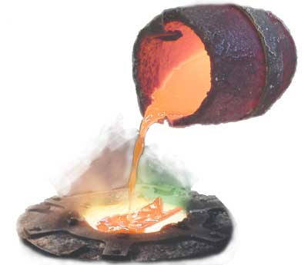
Regional Innovation Implementation Community (RIC)
Crucible 2, Valencia region
13, 14 November 2013
Notes:
<número>

Slide 2
Regional Innovation Implementation Community (RIC)
GOALS
share your harvest of this PiP year
get acquainted with Transition Management
learn about the regional innovation platforms
exercise with presentation and feed back
Notes:
This assignment will be done in the groups of about 6 to 7 participants
<número>

Slide 3
Regional Innovation Implementation Community (RIC)
Today
Sharing
learning experiences
Green economy, regional innovation platforms
Transition Management (TM)
Theory
Round Table
Assignment
Notes:
This assignment will be done in the groups of about 6 to 7 participants
<número>

Slide 4
Regional Innovation Implementation Community (RIC)
Tomorrow
Presentations
on results of TM assignment
Preparations for and presenting
PiP gains:
Elevator speech
Voluntary networking drinks
Closing at about
Notes:
This assignment will be done in the groups of about 6 to 7 participants
<número>

Slide 5
Regional Innovation Implementation Community (RIC)
Sharing PiP learning experiences
1
1
On first Post it: most important professional gain
2
On second Post-it: most important contextual lesson
3
On third Post-it: most important personal gain of this PiP year
4
Few min: discuss with your neighbour
5
We collect on on flip chart sheets and have a look together at the gains
2
3
4
5
Notes:
Only one thing per poster!
<número>

