Slide 1
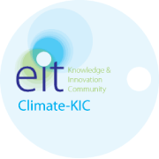
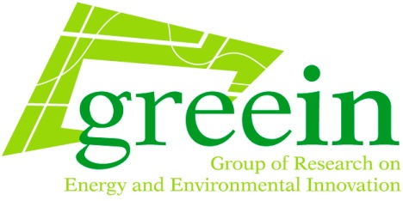
Regional Innovation Implementation Community (RIC)
Green economy and Platforms
Pioneers into Practice - Crucible II
Cristian Matti
Valencia, 14 November 2013

Slide 2
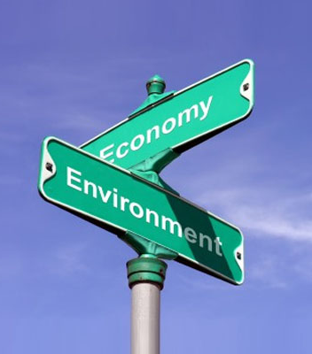
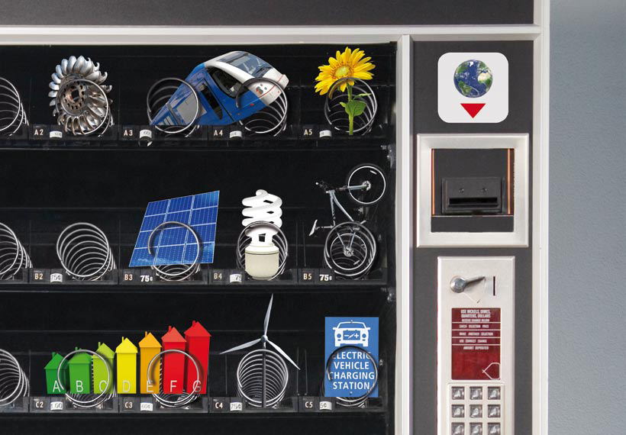
Green economy
According to OECD (2011)
“green growth means fostering economic growth and development by creating opportunities on the basis of ensuring natural assets to create and maintain provision of goods and services for society. Innovation is considered the key in this process by contributing to decouple growth from natural capital depletion through process of creative destruction which leads to new ideas, new business models and therefore new markets and new jobs.”
“This approach states that business is the main driver of green innovation while government action is critical to facilitate the context and overcome market failures.
The government interventions focus in specific aspects such as highlight trends by market signals, long term R&D support, and breaking path dependence and, facilitate diffusion and adoption of new technologies. “

Slide 3
Green economy by OECD
……does it sound familiar?
Does it sound like Mainstream?
Realize that to question is how we grow (to question is to grow)

Slide 4
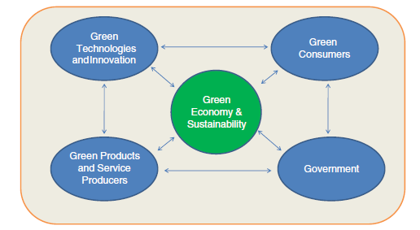
The quadruple green helix
What?
Change
Who?
Entrepreneurs- Society
How?
Experiments-pathway
Why?
System innovation
Source R. Gouvea et al. / Technological Forecasting & Social Change 80 (2013)

Slide 5
Some initial highlights on the “what” and “how” behind green platforms
Purpose, multilevel and scales
Motivation behind the creation of green technological platforms is the expected contribution to industry to response to societal needs in terms of economic, ecological and technological challenges. That means to face a wide and complex context of energy and environmental innovations characterized by the interaction of actors within a “multi and cross-scales” (i.e. public-private, several industrial sectors, research/education/training) and “multi and cross-level” (i.e. firm/cluster/network/industry, local/regional/national/European) innovation system.
Business model, long term perspective and resource management
Most of the platforms reviewed are oriented to accomplish long term goals in term of big frameworks as Horizon 2020, Europe 2020 strategy or European Joint Programing Initiatives (JPI). However, there are explicit arguments towards profit oriented approaches where profits obtained are reinvested in the platform activities. EU officer Arnaud Mercier (2012) has supported that approach by considering it functional to the current EU challenge of redesigning innovation policy instruments to foster new industries towards middle term competitive conditions.
Roles and activities
In order to follow the profit making oriented strategy, resource management, the design of activities and the role assigned to each actor have strong ties which are frequently referred to a value chain approach. Main activities can be included in categories as research training, professional education, entrepreneurship (startups, spin off) and R&D support. These activities are usually called pillars (e.g. KICs), challenges (e.g. JPI initiatives) or phases of transition (e.g. MUSIC cooperation project). Each of those areas responds to the strategic design of platform governance.
For example, KICs define co-location centers as Universities and research institutions in charge of promote process of knowledge creation. Then, outputs are link into a network of implementation sites geographically distribute across member regions and countries of the platform.
One example about research training and professional education is the Climate KIC programs. First, “the journey” (education pillar) is a five weeks training in four countries developed by these co-locations centers where participants are encourage developing business ideas and interacting with industries while they take business and innovation management courses. In the other hand, Pioneers in practice program (entrepreneurship pillar) is a two month mobility program aimed to promote cross-sectorial and cross-regional interaction.
Governance structure
The configuration of platforms follows a Public Private Partnership (PPP) approach in dimension, organizational structure and business model. Thus, even when decision processes are in charge of mixed governing boards, areas and entrepreneurship are leading by industries and R&D by universities within the same platforms.
However, energy and environmental problems can be addressed from higher levels but solutions are implemented locally. Thus, platforms are mostly designed by considering the knowledge triangle through geography perspectives so they may include organizations operating at national level (ECO-INNOVERA, WssTP, SUSTCHEM, MEDPRO) but also regions (KICs, JECP BSR, SPIRE ) and cities(MUSIC,EMI, UBC).
Some initial highlights on the “what” and “how” behind green platforms
Purpose, multilevel and scales
Motivation behind the creation of green technological platforms is the expected contribution to industry to response to societal needs in terms of economic, ecological and technological challenges.
It involves interaction of actors within a “multi and cross-scales” (i.e. public-private, several industrial sectors, research/education/training) and “multi and cross-level” (i.e. firm/cluster/network/industry, local/regional/national/European) innovation system.
Business model, long term perspective and resource management
Most of the platforms reviewed are oriented to accomplish long term goals in term of big frameworks as Horizon 2020, Europe 2020 strategy or European Joint Programing Initiatives (JPI). However, there are explicit arguments towards profit oriented approaches where profits obtained are reinvested in the platform activities.
Roles and activities
In order to follow the profit making oriented strategy, resource management, the design of activities and the role assigned to each actor have strong ties which are frequently referred to a value chain approach.
Governance structure
The configuration of platforms follows a Public Private Partnership (PPP) approach in dimension, organizational structure and business model. Thus, even when decision processes are in charge of mixed governing boards, areas as entrepreneurship are leading by industries and R&D by universities within the same platforms.

Slide 6
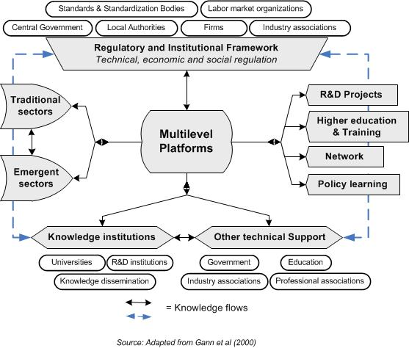
Multilevel Platforms
Purpose, multilevel and scales
Why?
Business model, long term perspective and resource management
What?
Roles and activities
Who?
Governance structure
How?

Slide 7
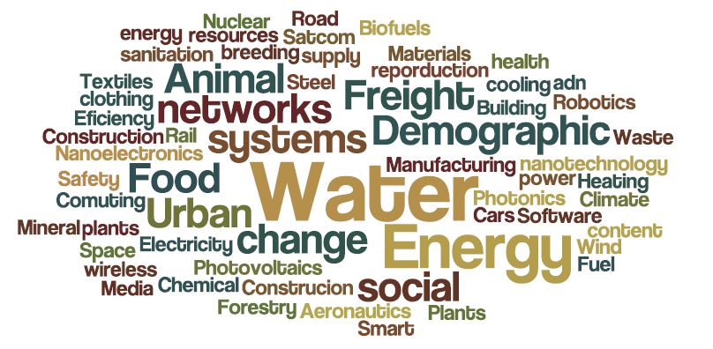
Platform | Sectors | Structure |  |  |  |  | Activities
 |  | Countries | Universities and R&D | Industry | Others | Total | Education & training | R&D | Networks | Policy
KIC Energy | Energy | 7 | 19 | 9 | 60 | 88 | 2 | 2 | 3 | 1
Climate KIC | Climate | 9 | 34 | 6 | 6 | 46 | 3 | 2 | 3 | 1
Eco-innovera | Ecoinnovation | 17 |  |  | 25 | 25 | 1 | 3 | 3 | 2
PPP Sprire | EE | 20 | 20 | 30 | 10 | 60 | 1 | 3 | 3 | 1
JPI Water | Water | 18 |  |  |  | 60 | 3 | 3 | 3 | 2
WssTP | Water | 15 | 47 | 14 | 19 | 60 |  | 3 | 2 | 2
MUSIC | Climate | 7 |  |  |  | 9 |  | 3 |  | 2
EMI | Climate | 19 | 3 |  | 14 | 14 | 2 | 2 | 2 | 1
UBC | Climate | 11 |  |  |  | 100 | 2 | 2 | 2 | 2
SusChem | Chemical | 11 |  |  | 6 |  | 2 | 2 | 2 | 2
BSSSC | Climate | 9 |  |  | 14 |  | 2 |  | 2 | 2
MEDPRO | Climate & energy | 13 | 17 |  |  | 17 | 2 | 2 | 2 | 1

Slide 8
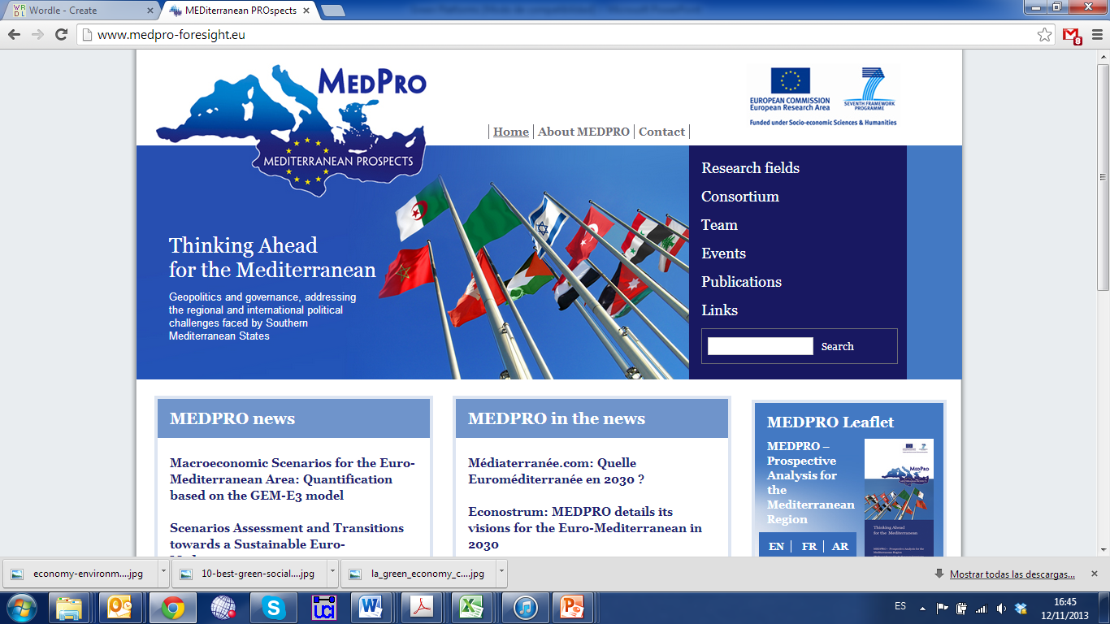
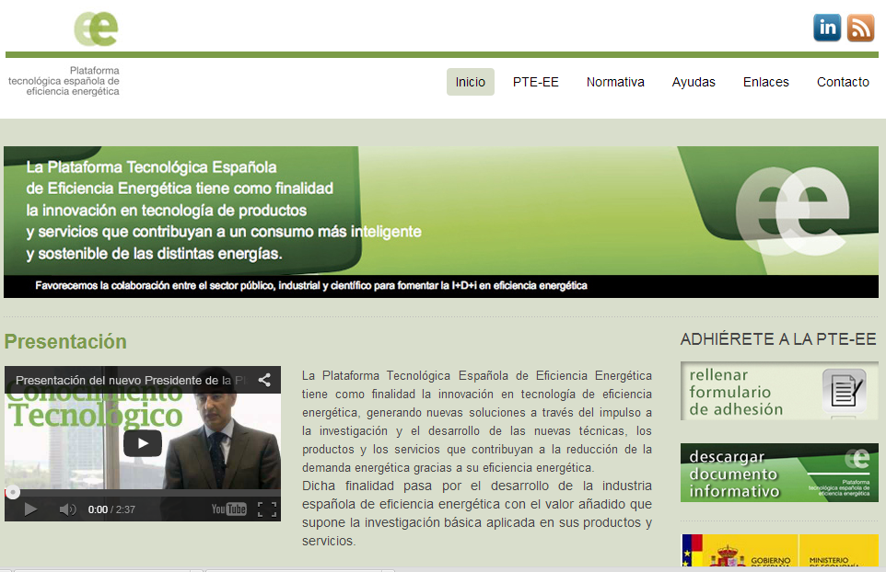
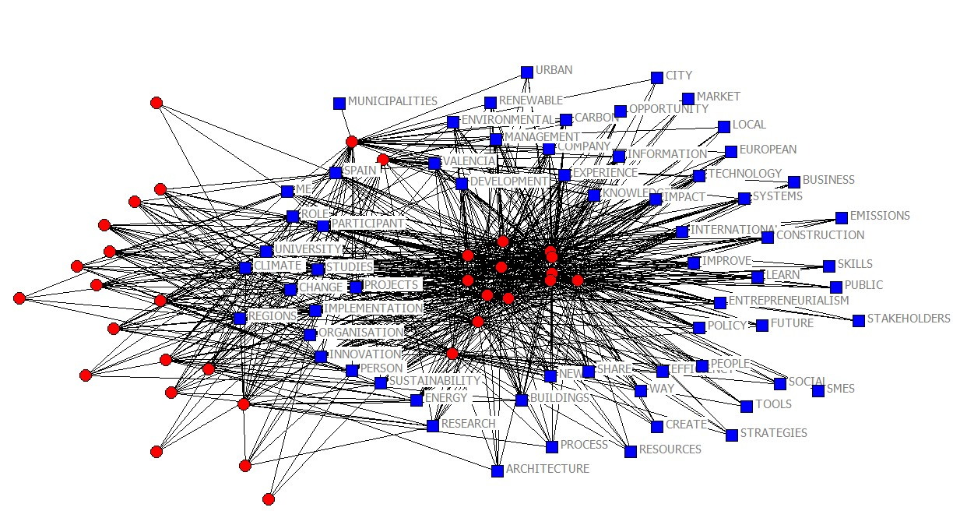
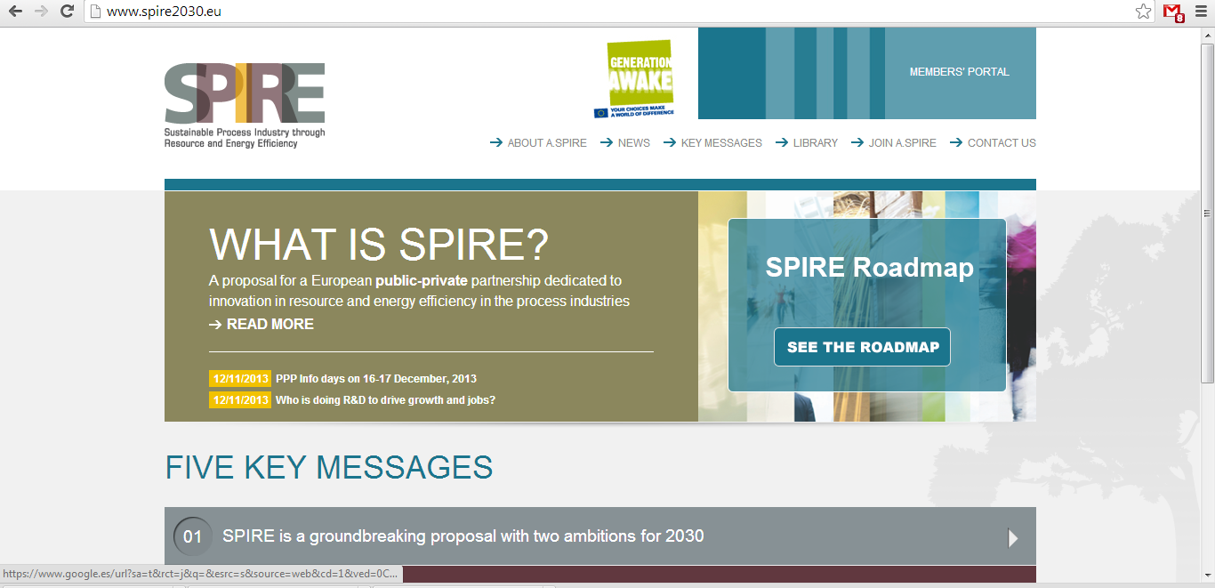
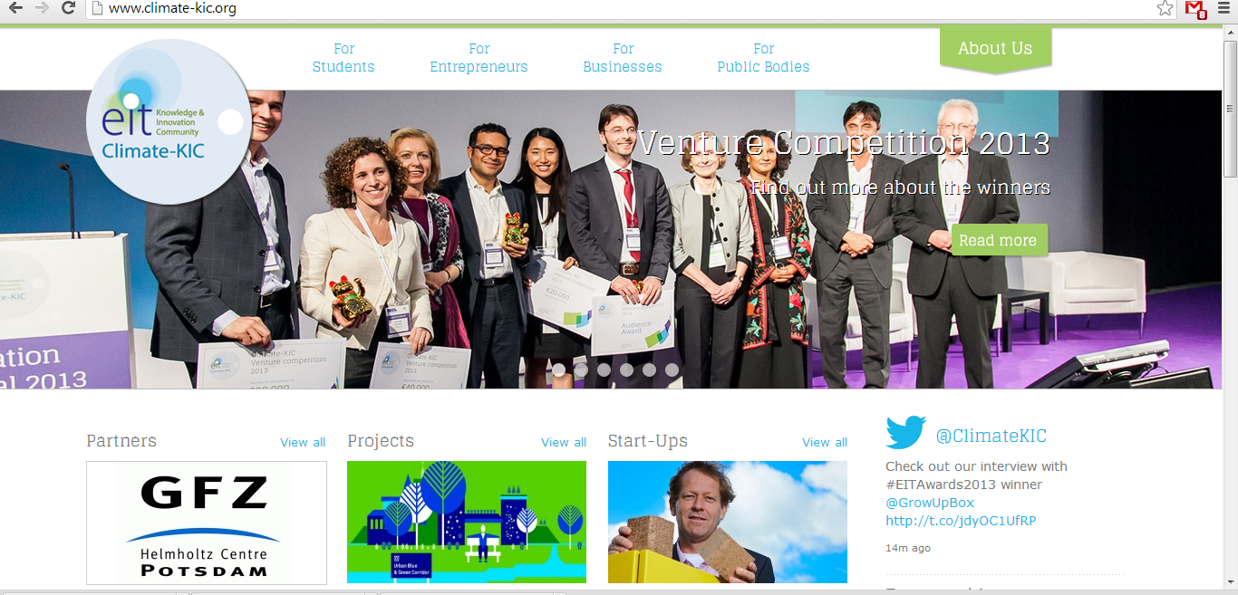
Thematic Network – Pioneers into Practice 2012 Valencia

Slide 9
Enjoy coffee¡
cristianmatti.com
#iMatti

