Slide 1
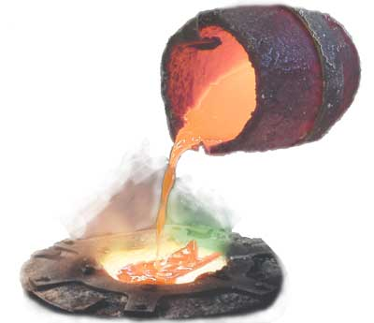
Regional Innovation Implementation Community (RIC)
Day 2 Crucible 2

Slide 2
Regional Innovation Implementation Community (RIC)
Results of TM assignment
Last preparations
presentations
Preparations for and presenting
PiP gains:
Elevator speech/
Other prepartations
Voluntary networking drinks
Closing at about 14:15
Notes:
This assignment will be done in the groups of about 6 to 7 participants

Slide 3
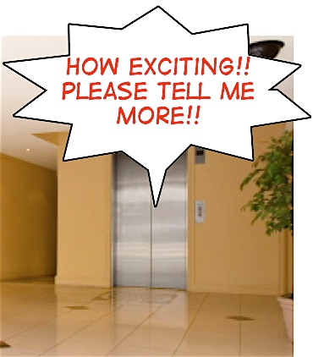
Regional Innovation Implementation Community (RIC)
‘ELEVATOR PITCH’

Slide 4
Regional Innovation Implementation Community (RIC)
GOALS
Find out what to tell you collegues, boss, manager…
Learn how to present short and effective
Excercising once more with feedback (according the rules)
Notes:
4

Slide 5
PREPARATIONS
Regional Innovation Implementation Community (RIC)
1
Individual preparations
15 minutes
2
Try-out with a partner
35 minutes
3
Presentations to group
About 2minutes/speech

Slide 6
Regional Innovation Implementation Community (RIC)
COMPOSE YOUR PITCH
1. Define your recipient: boss, collegue, board member?
3. Specify: what did
you get from the programme:
New competencies, that is…..
Network contacts
New insights
Project Ideas?
…
2. Think about: what of 2 and 3 could be
interesting to your recipient, and why?
4.. Ask yourself: is there anything that you would like as a follow up?
Notes:
Dus:
goals
recipiënt + what could be relevant for them?
What did you get from the programme? (and why important for your recipient?) – This is in fact the content of your pitch

Slide 7
Regional Innovation Implementation Community (RIC)
Feed back rules
Describe what you noticed.
Focus on the behaviour,
not the impression you had of it.
Describe the effect it had on you, and be specific . In this case it would especially be good if the feedback giver could mention the words or phrases that resonated with him or her when the speech was delivered
Check whether the person understands
what you are saying.
Finally, you could make positive
suggestions of what type of behaviour you
would like to see of the other..

